Slide 1
Completeness of Neural Networks for Boolean Functions

Slide 2
Boolean Functions: How many are there.
Look at Truth Tables.
  A Boolean function with n variables will have n+1 columns and 2^n rows for a look-up table of all values. (One row for each assignment of all the n variables to {T,F}
  The specific function is the value placed in the n+1 column
  So the number of different functions is the number of different ways {T,F} is placed in the n+1 column. How many different ways? And thereby # of different functions?
    2^[2^n] choices --- NOT A MISPRINT – i.e. super-exponential.
    Look at right column of following table.

Slide 3
Percentage of Boolean
Functions Representable by One Neuron
Input Perceptrons Functions
1 4 4
2 14 16
3 104 256
4 1,882 65,536
5 94,572 10**9
6 15,028,134 10**19
7 8,378,070,864 10**38
8 17,561,539,552,946 10**77

Slide 4

How many of these functions can be represented by a network of neurons?

Slide 5
How many of these functions can be represented by a network of neurons?
Answer: All of them. And by a network with 3 levels only.
We’ll prove it with four levels.
How?
You know (i) And, or, not can be represented by one neuron. (did it last time; although easiest to see if use {1, -1} to represent {T,F} (instead of {1,0} ) (bipolar instead of binary representation)
You once learned that every Boolean function can be represented in equivalent DNF, or CNF form. So theorem follows.
To remind you about the DNF form we continue …

Slide 6
We can represent conjuction of n variables (i.e. all must be T to be T)
By using value of weight 1 on each input, and a threshold of n-1/2.
We can represent disjunction of n variables as above but with a weight of ½.
Consider the following truth table (2^n rows, 2^n+1 columns) for an arbitrary Boolean Function. We wish to show you can get this function from a combination of and, or and not.
v1 | v2 |  |  |  | vn |  | value
T | T | T |  |  |  |  | t
F | T | T |  |  |  |  | f
T | F | T |  |  |  |  | f
F | F | T |  |  |  |  | t
 |  |  |  |  |  |  | f
etc |  |  |  |  |  |  | Etc for function

Slide 7
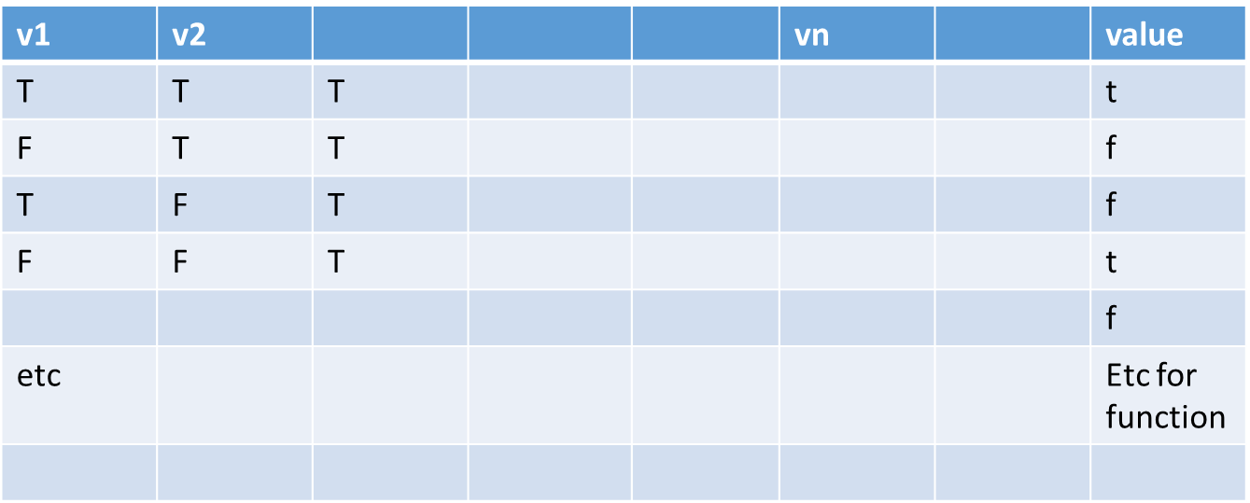
X_i Not X_i Chosen ANDs Chosen OR
(2^n neurons)

Slide 8
Define for each row, i, of inputs a “helping function g_i such that g_i has T only on row i .
We can get the g_i by looking at the row; and if we let z_j be v_j if v_j has “T” in its value in the row, and
let z_j be NOT v_j if v_j has value “F”.
Then let g_i be the conjunction (i.e. “and”) between all the z_js, j=1, …,n
Then the disjunction (“or”) of all the g_i s with row value I = T defines the desired Boolean function

Slide 10
Linearly Separable and Perceptron
How to Find weights EVEN if we know they exist? This is called Machine Learning
Use Perceptron slides
Note typical situation we don’t know if its linearly separable or not
Almost NEVER have full truth table for training as in perceptron algorithm
Interested in Generalization Error; willing to accept some errors in Training set

